Slide 1
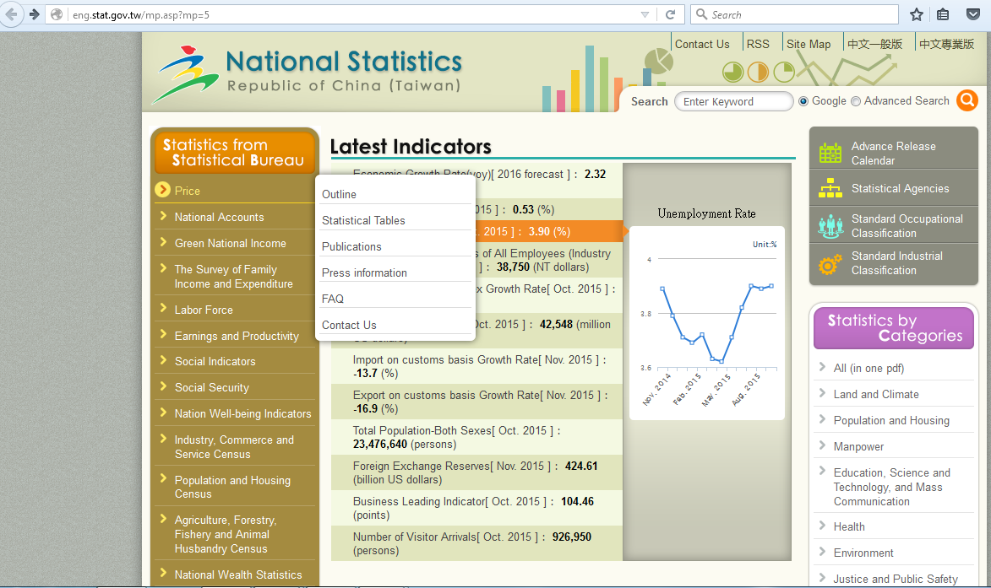
Procedure to obtain PPI data for Taiwan
Go to :
Click on “Price”
From the appearing menu click on “Publications”
eng.stat.gov.tw/mp.asp?mp=5

Slide 2
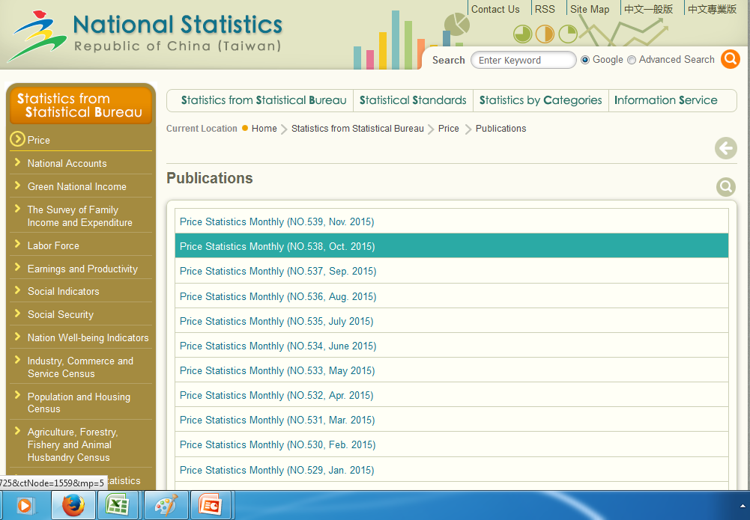
Procedure to obtain PPI data for Taiwan
Select the latest available publication of price statistics by clicking on “Price Statistics Monthly”
Ex: “Price Statistics Monthly (Oct 2015)”
`

Slide 3
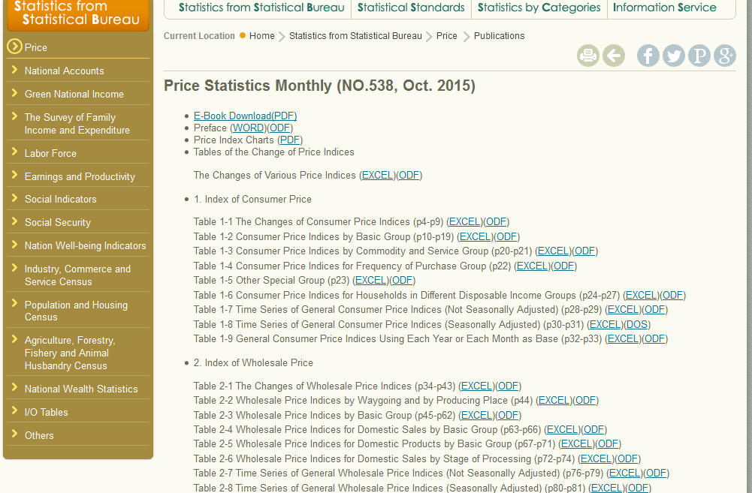
Procedure to obtain PPI data for Taiwan
Under “2. Index of Wholesale Price”
Look for “Table 2-3 Whole Price Indices by Basic Group”
Download the price index data by clicking “EXCEL”
`
`

Slide 4
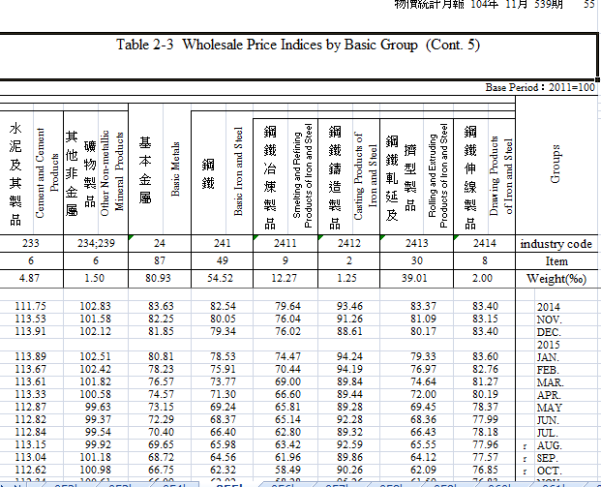
Procedure to obtain PPI data for Taiwan
The indices are displayed in the following manner, look for your product at the top
The index data is displayed below with the corresponding months in the far right column
`
`
`

